Slide 1

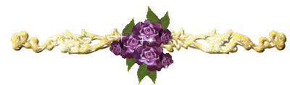
LY TU TRONG COLLEGE
ENGLISH DEPARTMENT
Teacher’s name:
VƯƠNG THANH THUỶ

Slide 2
AMERICAN ENGLISH FILE 2
(SECOND EDIDITON)
UNIT 5B: SUPERLATIVE CITIES

Slide 3

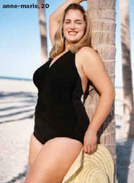
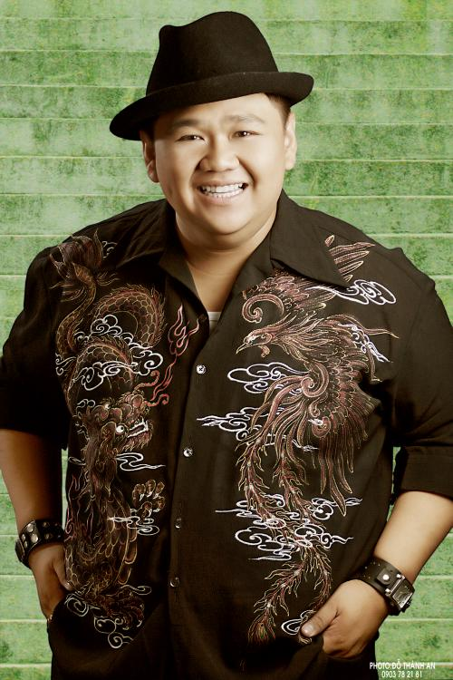
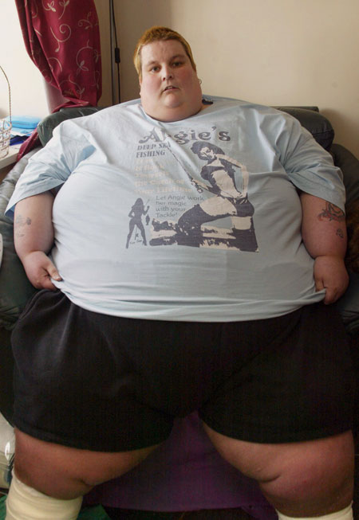
Oh no , I’m the fattest person .
I’m fatter than she is .
I’m fat .

Slide 4



It’s $ 500 . It’s cheap
It’s $ 300 . It’s cheaper than laptop .
Wow !!! It’s only $100 . It’s the cheapest one .

Slide 5
Comparative – Superlative with short adjective
Short Adjectives :
- One syllable : long , short , tall , big …..
- Two syllables ending in “ Y “ : happy , sunny , pretty……
* Comparative :
* Superlative :
Note : C-W-C ( big ) (bigger) (biggest)
Short Adjective + ER + THAN
THE +Short Adjective + EST

Slide 6


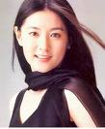
My Tam is beautiful .
Lam Tam Nhu is more beautiful than MT
Lee Young Ae is the most beautiful girl .

